Slide 1
JOIN

Slide 2
SQL | Join (Inner, eft, Right and Full Joins)
SQL Join statement is used to combine data or rows from two or more tables based on a common field between them. Different types of Joins are as follows:
INNER JOIN
LEFT JOIN
RIGHT JOIN
FULL JOIN
NATURAL JOIN
Consider the two tables below as follows:

Slide 3
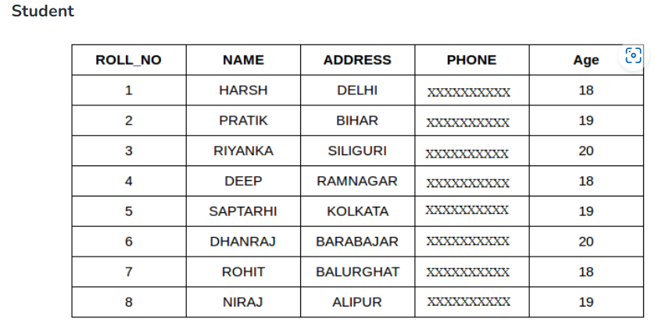
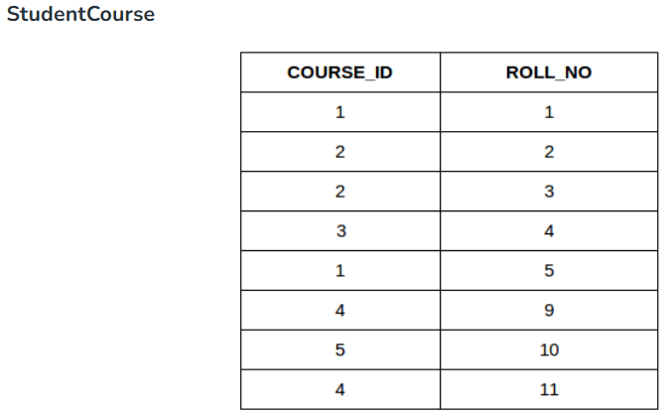

Slide 4
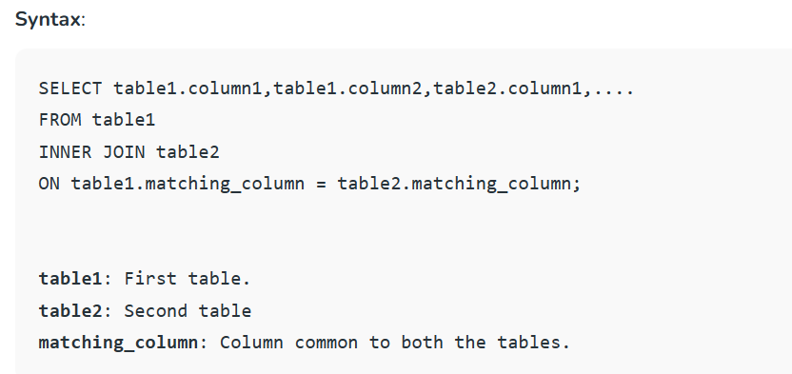
A. INNER JOIN
The INNER JOIN keyword selects all rows from both the tables as long as the condition is satisfied. This keyword will create the result-set by combining all rows from both the tables where the condition satisfies i.e value of the common field will be the same.

Slide 5
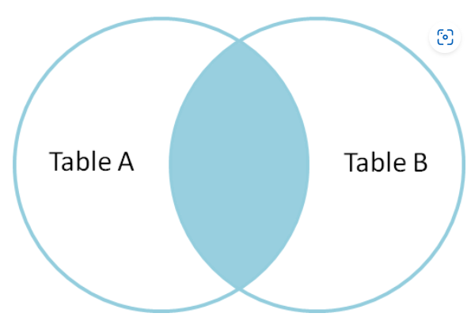
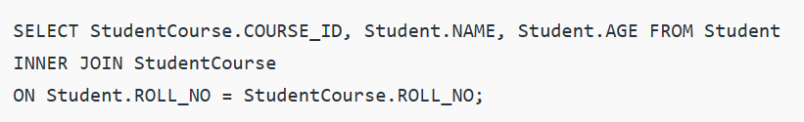
Example Queries(INNER JOIN)
This query will show the names and age of students enrolled in different courses

Slide 6
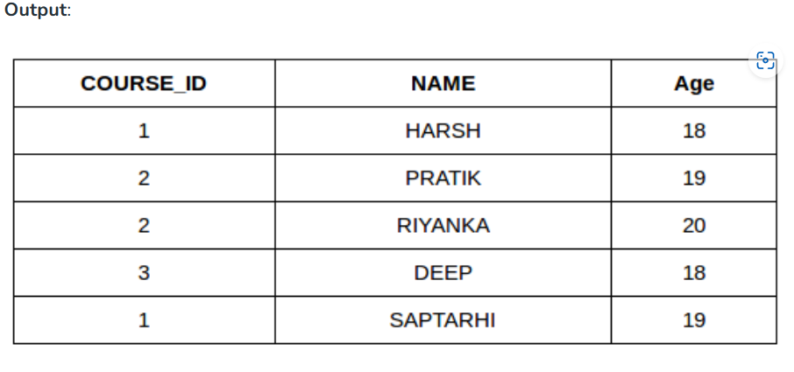

Slide 7
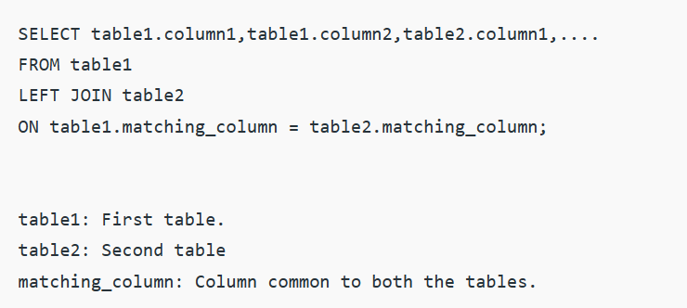
B. LEFT JOIN
This join returns all the rows of the table on the left side of the join and matches rows for the table on the right side of the join. For the rows for which there is no matching row on the right side, the result-set will contain null. LEFT JOIN is also known as LEFT OUTER JOIN.
Syntax:

Slide 8
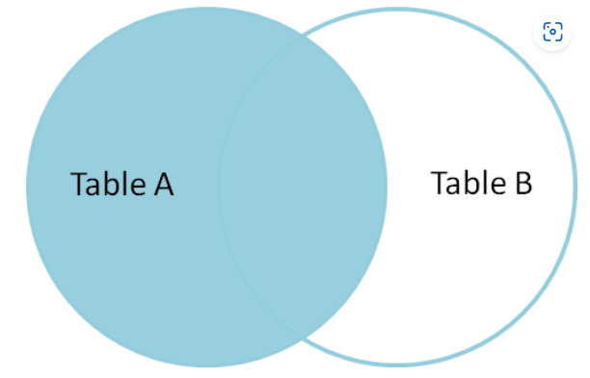
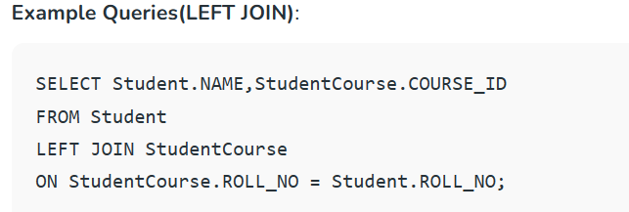
Note: We can also use LEFT OUTER JOIN instead of LEFT JOIN, both are the same.

Slide 9
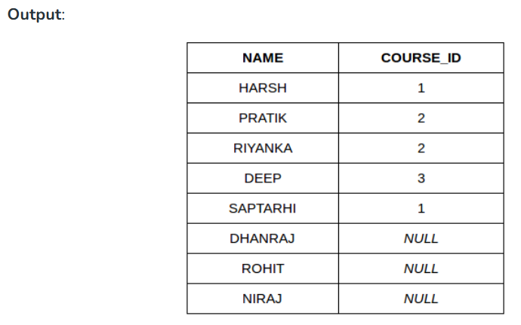

Slide 10
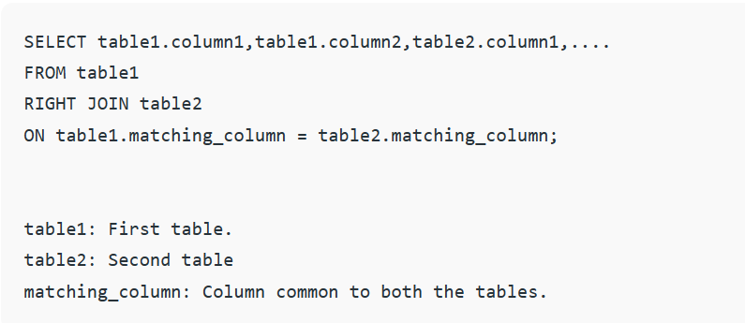
C. RIGHT JOIN
RIGHT JOIN is similar to LEFT JOIN. This join returns all the rows of the table on the right side of the join and matching rows for the table on the left side of the join. For the rows for which there is no matching row on the left side, the result-set will contain null. RIGHT JOIN is also known as RIGHT OUTER JOIN.
Syntax:

Slide 11
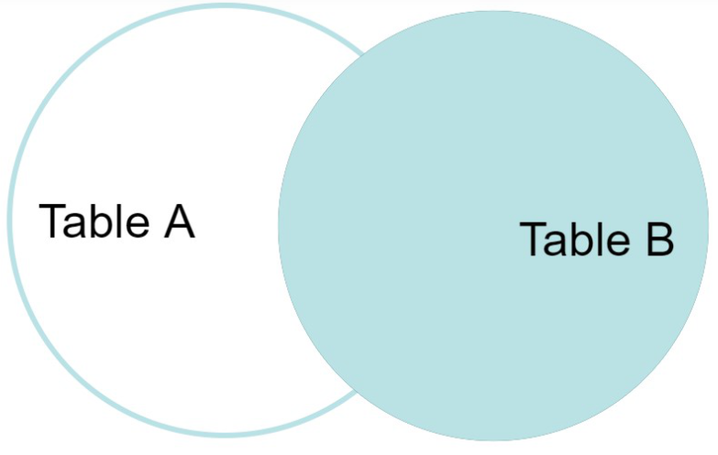
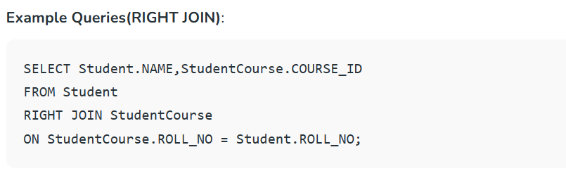
Note: We can also use RIGHT OUTER JOIN instead of RIGHT JOIN, both are the same.

Slide 12
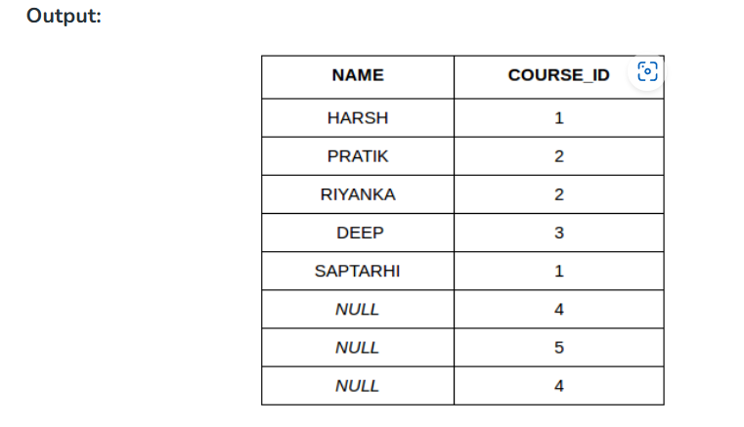

Slide 13
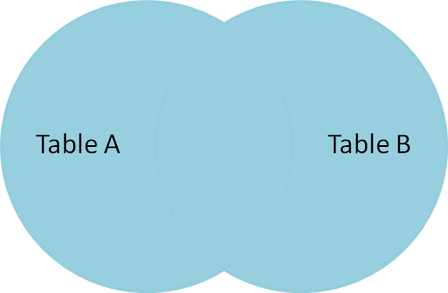
D. FULL JOIN
FULL JOIN creates the result-set by combining results of both LEFT JOIN and RIGHT JOIN. The result-set will contain all the rows from both tables. For the rows for which there is no matching, the result-set will contain NULL values.

Slide 14
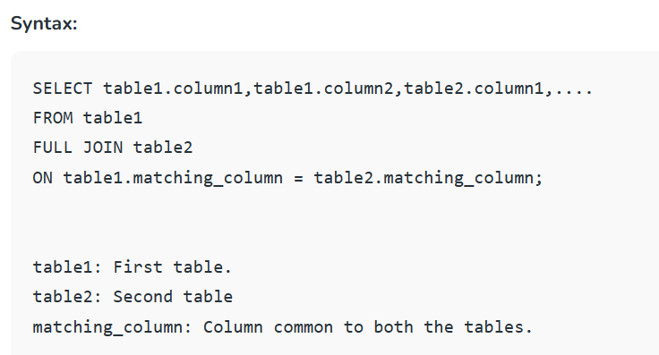
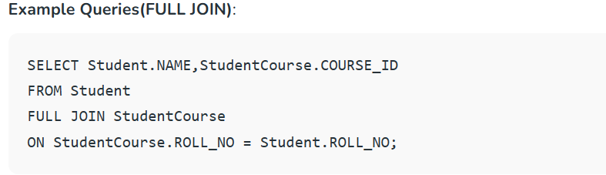

Slide 15
Output
NAME | COURSE_ID
HARSH | 1
PRATIK | 2
RIYANKA | 2
DEEP | 3
SAPTARTHI | 1
DHANRAJ | NULL
ROHIT | NULL
NIRAJ | NULL
NULL | 4
NULL | 5
NULL | 4

Slide 16
E. Natural join (⋈)
Natural join can join tables based on the common columns in the tables being joined. A natural join returns all rows by matching values in common columns having same name and data type of columns and that column should be present in both tables.
Both table must have at list one common column with same column name and same data type.
The two table are joined using Cross join.
DBMS will look for a common column with same name and data type Tuples having exactly same values in common columns are kept in result.

Slide 17
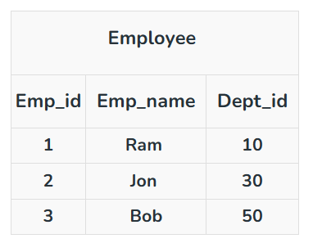
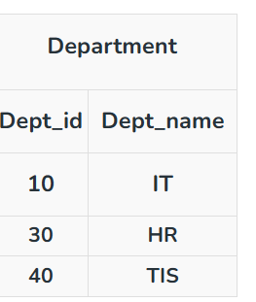
Example:

Slide 18
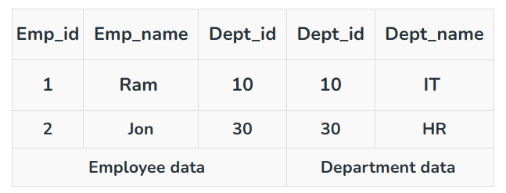
Query: Find all Employees and their respective departments.
Solution: (Employee) ⋈ (Department)

